Slide 1

Notes:
It’s National Road Safety Week 11-18th May

Slide 2
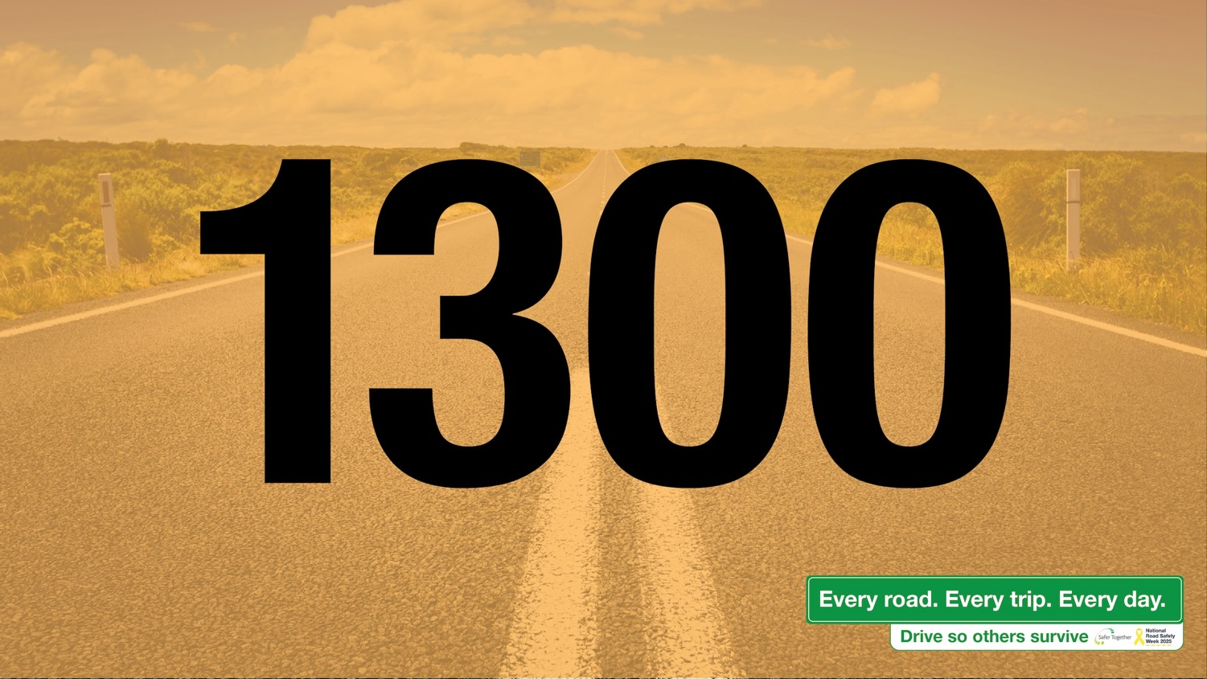
Notes:
It’s a sobering number

Slide 3
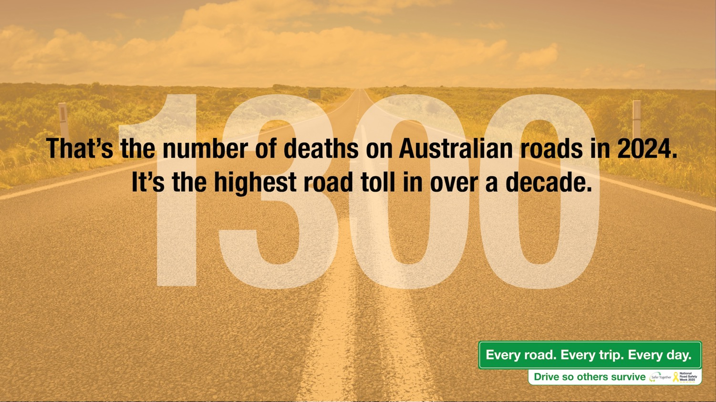
Notes:
The highest road toll in over a decade

Slide 4

Notes:
18th

Slide 5
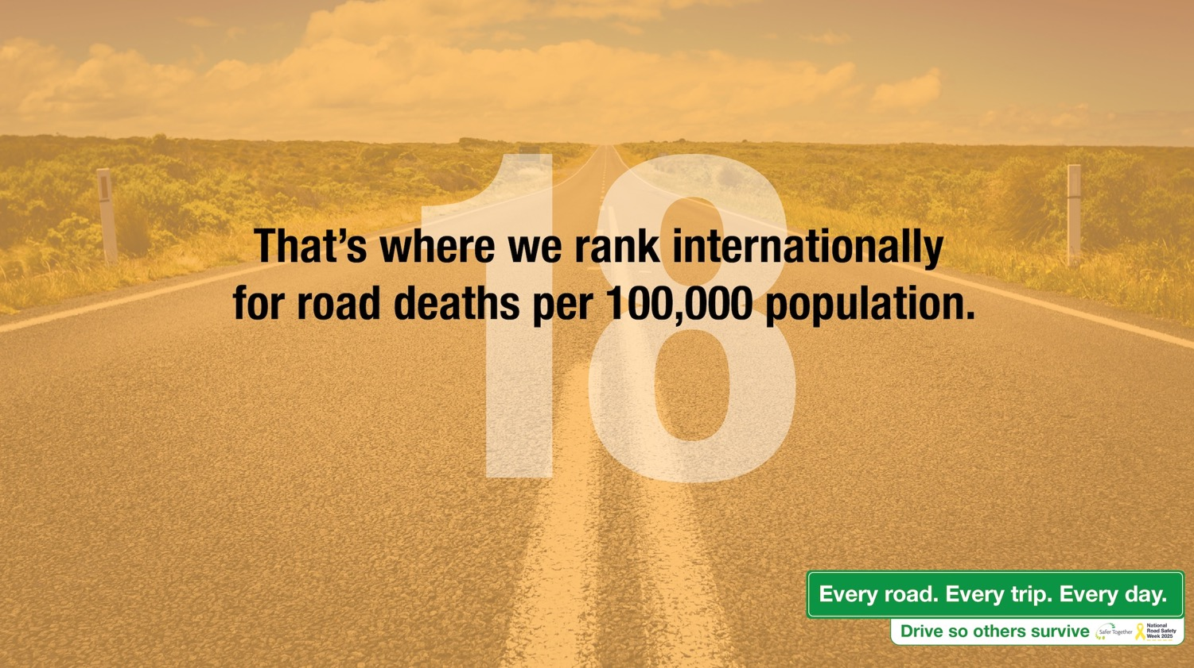
Notes:
We’re ranked 18th across the world for road deaths per 100,000.

Slide 6

Notes:
6

Slide 7
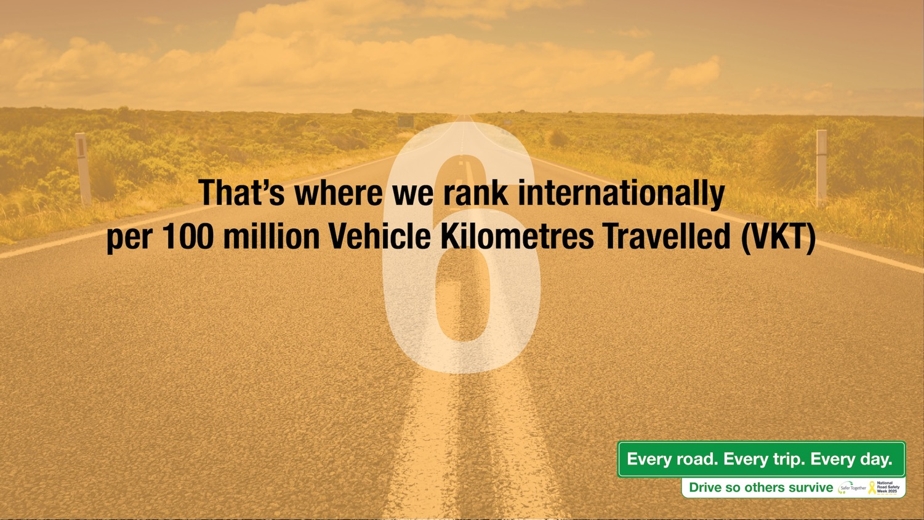
Notes:
We’re ranked 6th across the world for VKT

Slide 8

Notes:
We work in regional areas

Slide 9
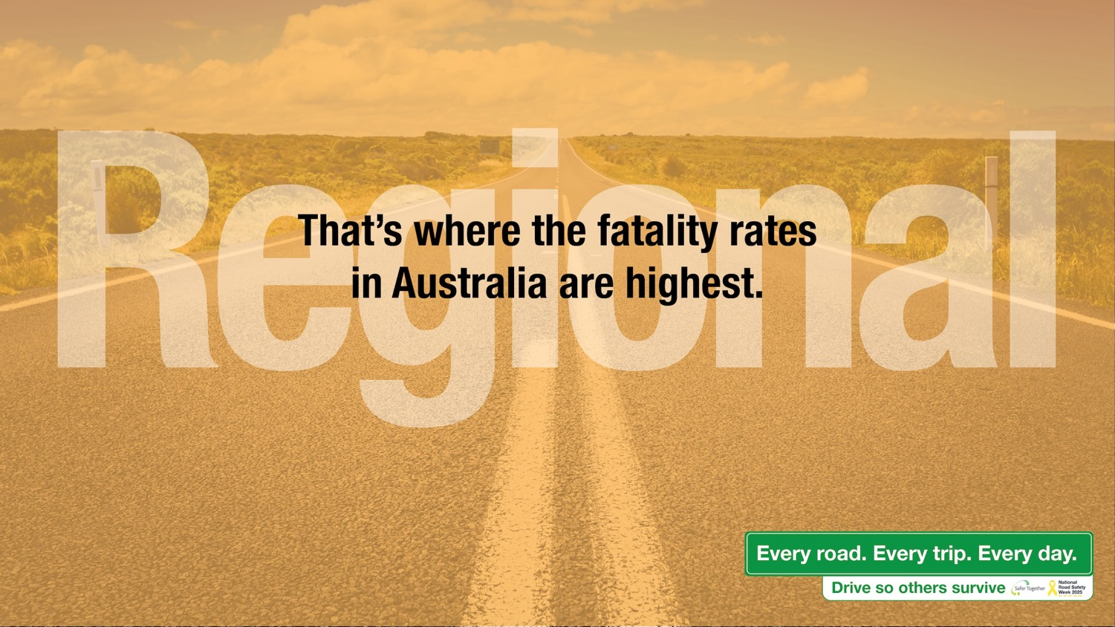
Notes:
Statistics show that this is where the fatality rates are highest

Slide 10

Notes:
Driving is part of our daily lives. It’s a responsibility that we should always take seriously.

Slide 11
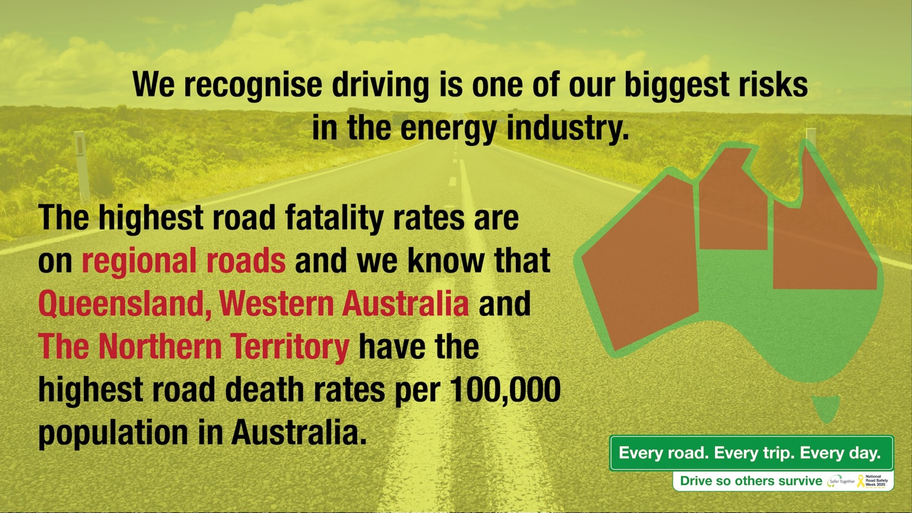
Notes:
Driving is one of the biggest risks for our industry and importantly the statistics show that the areas where we mostly work – QLD, WA/NT have a higher proportion of death rates per 100,000 than the rest of Australia.

Slide 12
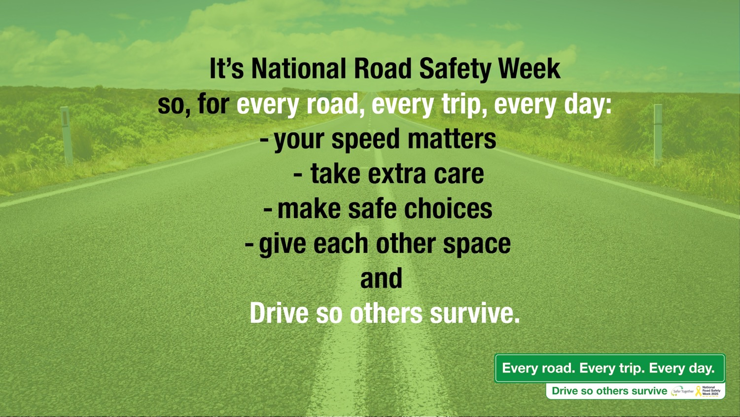
Notes:
It’s National Road Safety Week – next week – 11-18 May.
Your Speed Matters
Take Extra care
Make Safe Choices
Give each other space
Every Road, Every trip, Every Day – Drive so others survive

Slide 13

Notes:
Take the pledge!

Slide 14
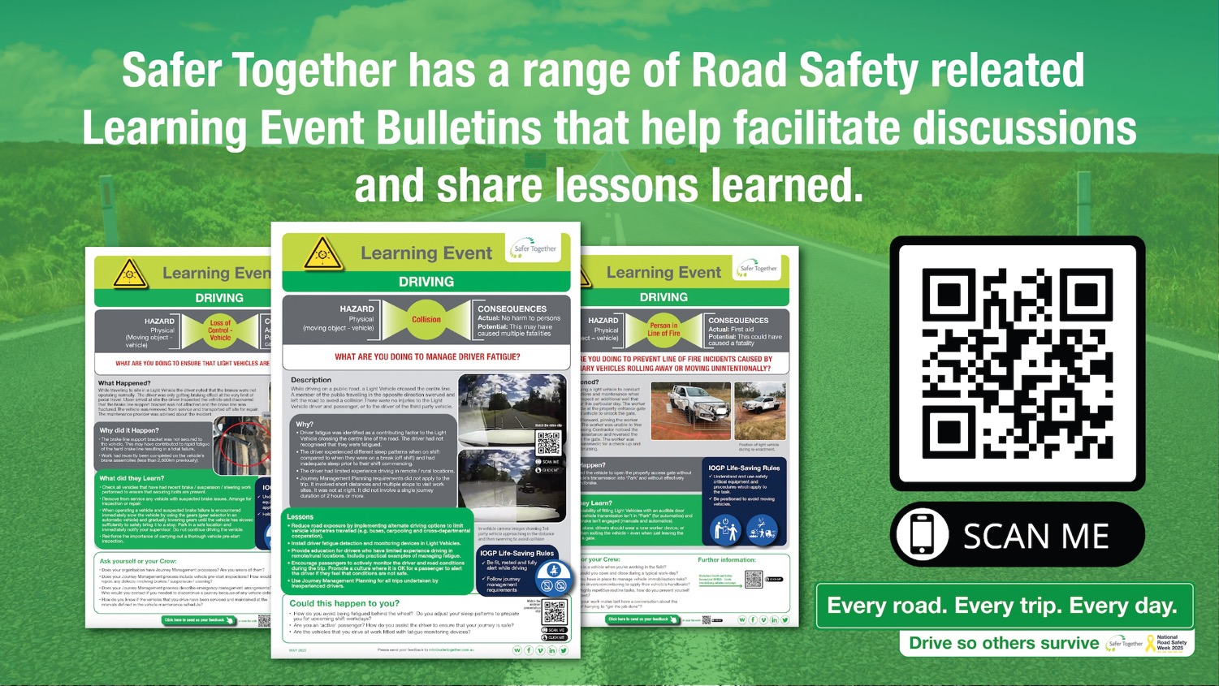
Notes:
Safer Together has a library of LEBs and lots of these are related to road safety. Use them in your workplace to share lessons learned.

Slide 15

Notes:
The Safer Together Land Transport Working Group has spent many years developing fantastic resources that support our efforts in the road safety space. Check them out and put them to good use.

Slide 16
Notes:
Every Road
Every Trip
Every Day
Drive so Others Survive…..

